Slide 1
Convolutional Neural Network (CNN)
Dr. Noman Islam

Slide 2
Introduction
Convolutional Neural Networks (ConvNets or CNNs) are a category of Neural Networks that have proven very effective in areas such as image recognition and classification. ConvNets have been successful in identifying faces, objects and traffic signs apart from powering vision in robots and self driving cars.
Very similar to ordinary ANN
ConvNet architectures make the explicit assumption that the inputs are images, which allows us to encode certain properties into the architecture.
Regular Neural Nets don’t scale well to full images

Slide 3
For example, an image of more respectable size, e.g. 200x200x3, would lead to neurons that have 200*200*3 = 120,000 weights.
Moreover, we would almost certainly want to have several such neurons, so the parameters would add up quickly!
Clearly, this full connectivity is wasteful and the huge number of parameters would quickly lead to overfitting

Slide 4
ConvNets
A simple ConvNet is a sequence of layers, and every layer of a ConvNet transforms one volume of activations to another through a differentiable function.
Convolutional Layer, Pooling Layer, and Fully-Connected Layer

Slide 5
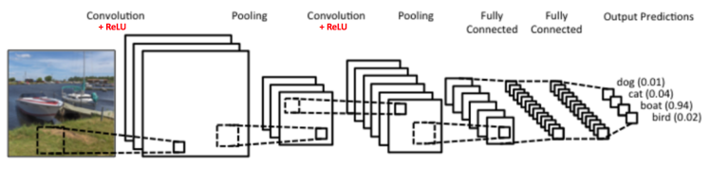
LeeNet Architecture

Slide 6
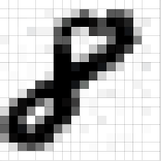
Input Layer
Essentially, every image can be represented as a matrix of pixel values.
Channel is a conventional term used to refer to a certain component of an image. An image from a standard digital camera will have three channels – red, green and blue – you can imagine those as three 2d-matrices stacked over each other (one for each color), each having pixel values in the range 0 to 255.

Slide 7
A grayscale image, on the other hand, has just one channel.
For the purpose of this example , we will only consider grayscale images, so we will have a single 2d matrix representing an image. The value of each pixel in the matrix will range from 0 to 255 – zero indicating black and 255 indicating white.

Slide 8

Convolution

Slide 9
The primary purpose of Convolution in case of a ConvNet is to extract features from the input image.
Convolution preserves the spatial relationship between pixels by learning image features using small squares of input data.
We slide the orange matrix over our original image (green) by 1 pixel (also called ‘stride’) and for every position, we compute element wise multiplication (between the two matrices) and add the multiplication outputs to get the final integer which forms a single element of the output matrix (pink).
Note that the 3×3 matrix “sees” only a part of the input image in each stride.

Slide 10
In CNN terminology, the 3×3 matrix is called a ‘filter‘ or ‘kernel’ or ‘feature detector’ and the matrix formed by sliding the filter over the image and computing the dot product is called the ‘Convolved Feature’ or ‘Activation Map’ or the ‘Feature Map‘.
It is important to note that filters acts as feature detectors from the original input image.

Slide 11
We can perform operations such as Edge Detection, Sharpen and Blur just by changing the numeric values of our filter matrix before the convolution operation
This means that different filters can detect different features from an image, for example edges, curves etc

Slide 12


Slide 13


Slide 14
In practice, a CNN learns the values of these filters on its own during the training process
The size of the Feature Map (Convolved Feature) is controlled by three parameters:
Depth: Depth corresponds to the number of filters we use for the convolution operation.
Stride: Stride is the number of pixels by which we slide our filter matrix over the input matrix. When the stride is 1 then we move the filters one pixel at a time

Slide 15
Zero-padding: Sometimes, it is convenient to pad the input matrix with zeros around the border, so that we can apply the filter to bordering elements of our input image matrix. A nice feature of zero padding is that it allows us to control the size of the feature maps. Adding zero-padding is also called wide convolution, and not using zero-padding would be a narrow convolution.

Slide 16
ReLu
An additional operation called ReLU has been used after every Convolution operation
ReLU is an element wise operation (applied per pixel) and replaces all negative pixel values in the feature map by zero. The purpose of ReLU is to introduce non-linearity in our ConvNet

Slide 17
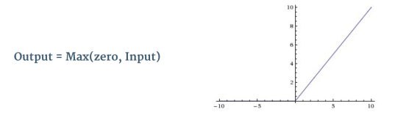

Slide 18


Slide 19
Pooling Step
Spatial Pooling (also called subsampling or downsampling) reduces the dimensionality of each feature map but retains the most important information.
Spatial Pooling can be of different types: Max, Average, Sum etc.

Slide 20
In case of Max Pooling, we define a spatial neighborhood (for example, a 2×2 window) and take the largest element from the rectified feature map within that window.
Instead of taking the largest element we could also take the average (Average Pooling) or sum of all elements in that window.
In practice, Max Pooling has been shown to work better.

Slide 21
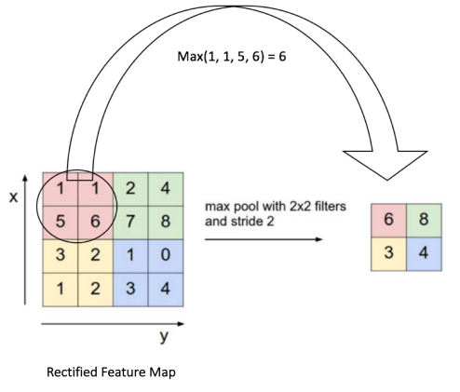

Slide 22
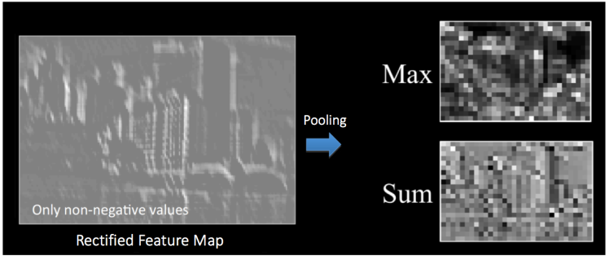

Slide 23
Effect of Pooling
Makes the input representations (feature dimension) smaller and more manageable
Reduces the number of parameters and computations in the network, therefore, controlling overfitting
Makes the network invariant to small transformations, distortions and translations in the input image (a small distortion in input will not change the output of Pooling – since we take the maximum / average value in a local neighborhood).
Helps us arrive at an almost scale invariant representation of our image (the exact term is “equivariant”). This is very powerful since we can detect objects in an image no matter where they are located

Slide 24
So far we have seen how Convolution, ReLU and Pooling work.
It is important to understand that these layers are the basic building blocks of any CNN.
We have two sets of Convolution, ReLU & Pooling layers – the 2nd Convolution layer performs convolution on the output of the first Pooling Layer using six filters to produce a total of six feature maps.
ReLU is then applied individually on all of these six feature maps. We then perform Max Pooling operation separately on each of the six rectified feature maps.

Slide 25
Together these layers extract the useful features from the images, introduce non-linearity in our network and reduce feature dimension while aiming to make the features somewhat equivariant to scale and translation

Slide 26
Fully Connected Layer
The Fully Connected layer is a traditional Multi Layer Perceptron that uses a softmax activation function in the output layer (other classifiers like SVM can also be used, but will stick to softmax in this post).
The term “Fully Connected” implies that every neuron in the previous layer is connected to every neuron on the next layer.

Slide 27
The output from the convolutional and pooling layers represent high-level features of the input image.
The purpose of the Fully Connected layer is to use these features for classifying the input image into various classes based on the training dataset.

Slide 28
Apart from classification, adding a fully-connected layer is also a (usually) cheap way of learning non-linear combinations of these features.
Most of the features from convolutional and pooling layers may be good for the classification task, but combinations of those features might be even better

Slide 29
The sum of output probabilities from the Fully Connected Layer is 1
This is ensured by using the Softmax as the activation function in the output layer of the Fully Connected Layer.
The Softmax function takes a vector of arbitrary real-valued scores and squashes it to a vector of values between zero and one that sum to one.

Slide 30
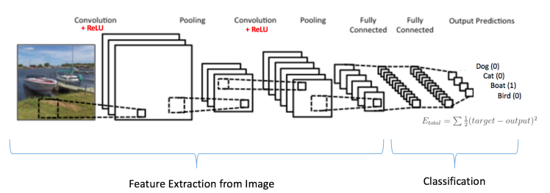
Training the CNN

Slide 31
Step1: We initialize all filters and parameters / weights with random values
Step2: The network takes a training image as input, goes through the forward propagation step (convolution, ReLU and pooling operations along with forward propagation in the Fully Connected layer) and finds the output probabilities for each class.

Slide 32
Lets say the output probabilities for the boat image above are [0.2, 0.4, 0.1, 0.3]. Since weights are randomly assigned for the first training example, output probabilities are also random.
Step3: Calculate the total error at the output layer (summation over all 4 classes)
Total Error = ∑ ½ (target probability – output probability) ²

Slide 33
Step4: Use Backpropagation to calculate the gradients of the error with respect to all weights in the network and use gradient descent to update all filter values / weights and parameter values to minimize the output error. The weights are adjusted in proportion to their contribution to the total error. When the same image is input again, output probabilities might now be [0.1, 0.1, 0.7, 0.1], which is closer to the target vector [0, 0, 1, 0]. This means that the network has learnt to classify this particular image correctly by adjusting its weights / filters such that the output error is reduced.

Slide 34
Parameters like number of filters, filter sizes, architecture of the network etc. have all been fixed before Step 1 and do not change during training process – only the values of the filter matrix and connection weights get updated.
Step5: Repeat steps 2-4 with all images in the training set.

Slide 35
When a new (unseen) image is input into the ConvNet, the network would go through the forward propagation step and output a probability for each class (for a new image, the output probabilities are calculated using the weights which have been optimized to correctly classify all the previous training examples).
If our training set is large enough, the network will (hopefully) generalize well to new images and classify them into correct categories.

Slide 36
Please note however, that these operations can be repeated any number of times in a single ConvNet.
In fact, some of the best performing ConvNets today have tens of Convolution and Pooling layers!
Also, it is not necessary to have a Pooling layer after every Convolutional Layer.

Slide 37
Visualizing CNN
In general, the more convolution steps we have, the more complicated features our network will be able to learn to recognize.
For example, in Image Classification a ConvNet may learn to detect edges from raw pixels in the first layer, then use the edges to detect simple shapes in the second layer, and then use these shapes to deter higher-level features, such as facial shapes in higher layers

Slide 38
Applications of CNN
Image Recognition
Video Analysis
NLP
Drug Discovery
Playing Go

